Slide 1
GAME LOCKER
Cryptography Project Presentation

Slide 2
About:
The game locker will encrypt a file with a certain key which we get from the user after playing a game. The score at which the user finishes his/her game acts as the key which later along with the entered password goes through the AES algorithm. Plain text will be user inputed text and Key will be string returned after completion of Game, this plain text and Key will be sent to AES and file will be encrypted with cipher text.Thus, an overall foolproof system is created where nobody can break into other’s work without the proper key.
We chose Game Locker as our project, because it is quite interesting and we thought while making this we can have fun and a learning experience.

Slide 3
Features:
We developed the Game Locker application in such a way that the user needs to give two inputs: filename and a password(like a public key). Then, if user A wants to send a file to user B, then they can use this application for a smooth flow of work. It is so because gamelocker has the following features: Integrity, confidentiality and authenticity.
Our application does some operations which will be discussed shortly. A basic explanation would be as follows: at end of operations, the application will provide a key/code with which we encrypt file (key/code is different from the user input public key). In such a way, the file is Encrypted.
Similarly, the decryption of file can also be performed using our application. The User B needs user A to input key and a secret key which is generated through game. Then they will be moved through the AES algorithm and the process of decryption takes place.

Slide 4
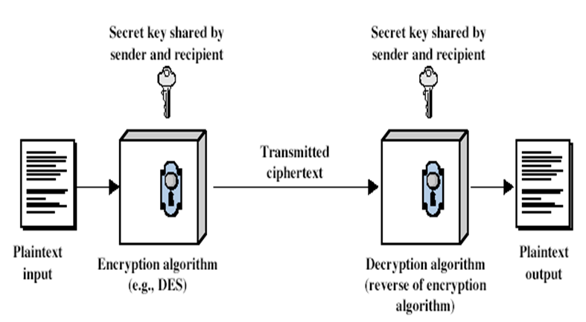
Encryption and Decryption
Encryption: User A public key(PLAIN TEXT)+seckey from Game(KEY)=>AES=>(CIPHER TEXT)=>encrypt file
Decryption: User B public key (PlainText)+seckey from game(KEY)=>AES=>(CIPHER TEXT)=>decrypt file.

Slide 5
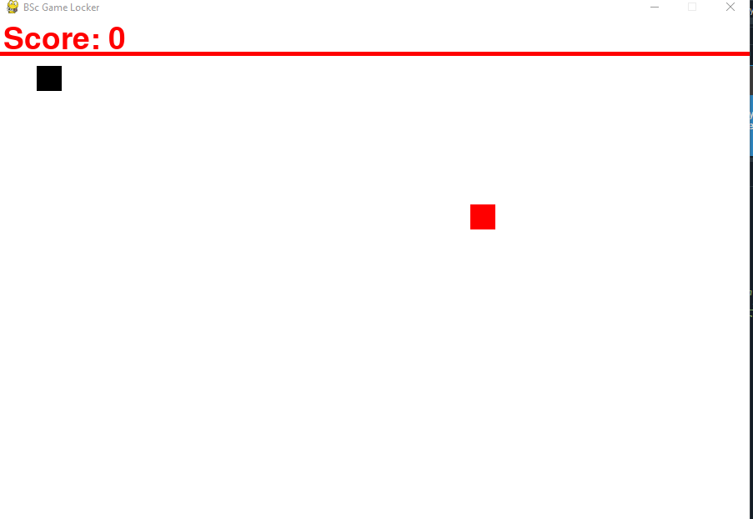
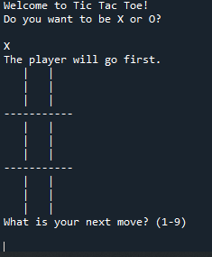
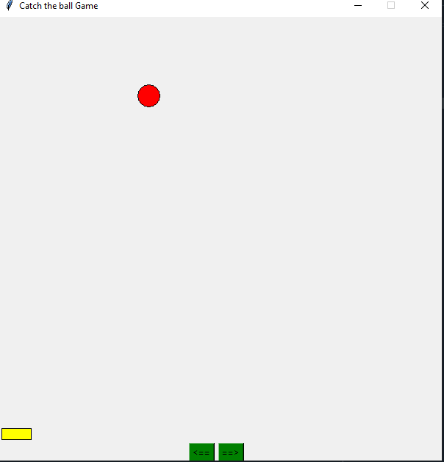
Games Provided:
The Hungry Snake
Tic Tac Toe
Catch The Ball

Slide 6
Sample Run
.

